Slide 1

CSE 350 Digital Electronics and Pulse Techniques
Analog to Digital Converter (ADC)
Course Instructor: Shomen Kundu (SDU)
Mail: shomen.kundu@bracu.ac.bd
Desk: 4N166

Slide 2
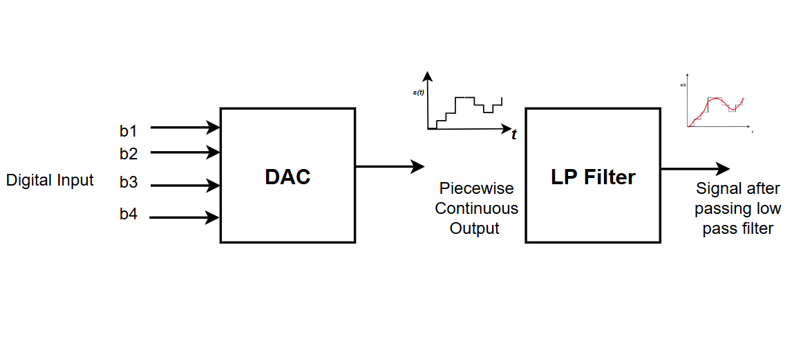
Digital to Analog Converter (DAC)

Slide 3
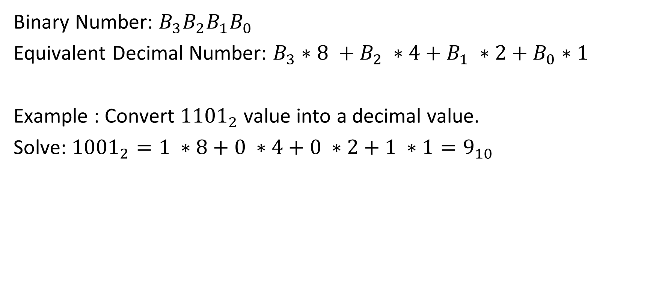
Binary to Decimal Conversion
Binary Number: ${B_{3}B_{2}B_{1}B}_{0}$
Equivalent Decimal Number: $B_{3}∗8 +B_{2} ∗4+B_{1} ∗2+B_{0}∗1$
Example : Convert ${1101}_{2}$value into a decimal value.
Solve: ${1001}_{2}=1 ∗8+0 ∗4+0 ∗2+1 ∗1=9_{10}$

Slide 4
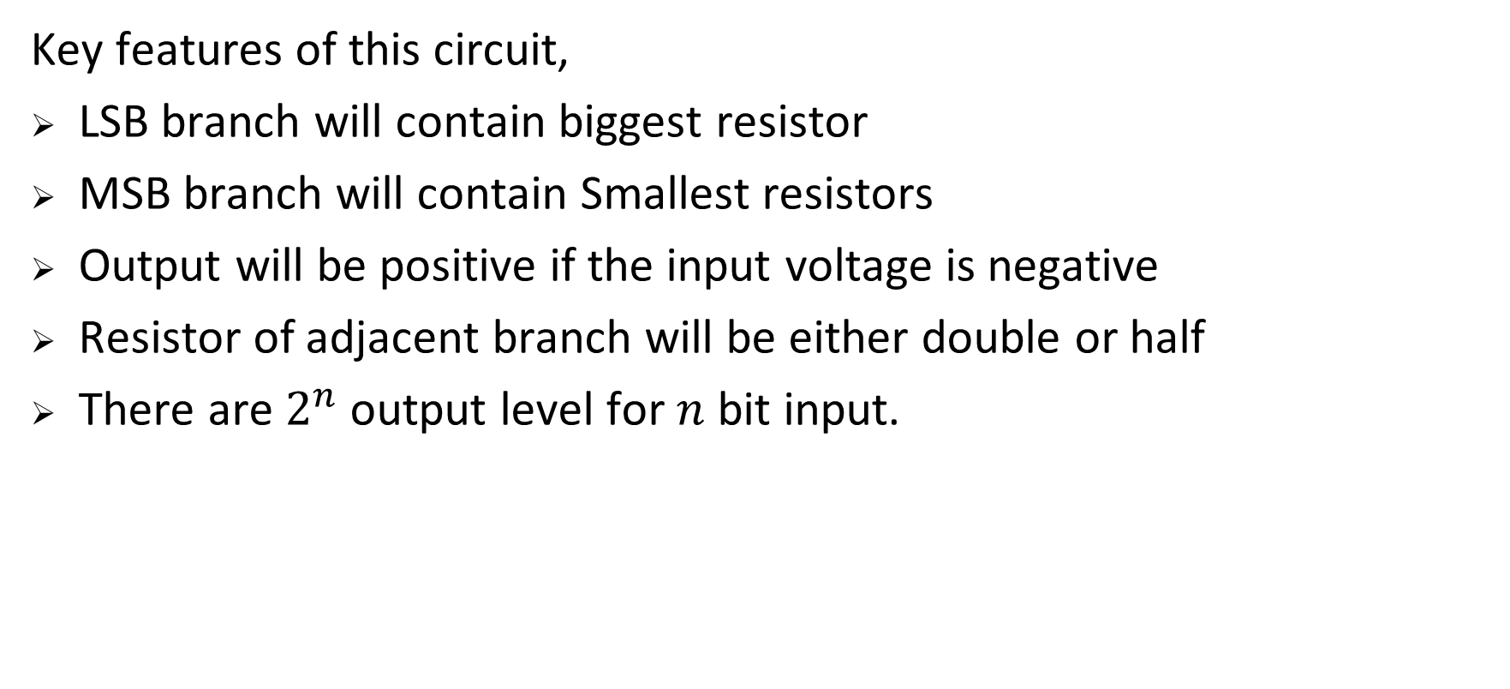
Binary Weighted DAC
Key features of this circuit,
LSB branch will contain biggest resistor
MSB branch will contain Smallest resistors
Output will be positive if the input voltage is negative
Resistor of adjacent branch will be either double or half
There are $2^{n}$output level for $n$ bit input.

Slide 5
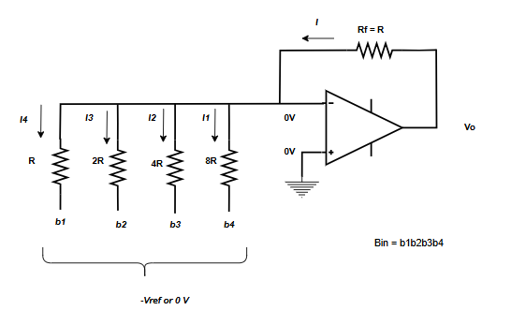
Output of the DAC circuit

Slide 6
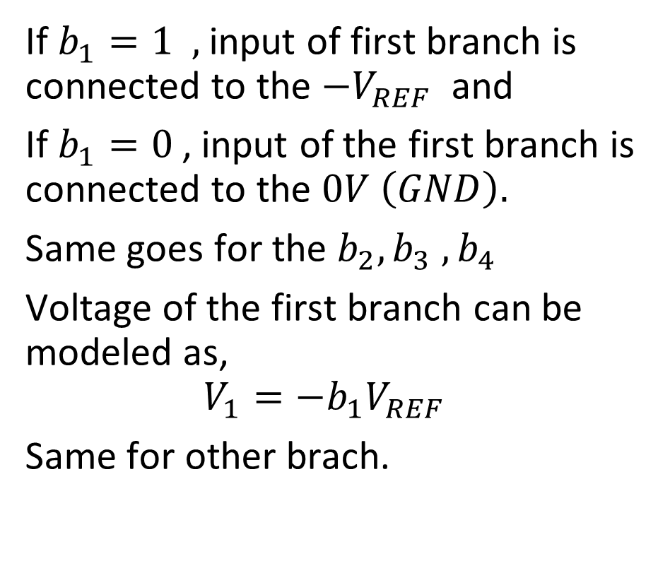
Digital to Analog Converter (DAC)
If $b_{1}=1 ,$ input of first branch is connected to the $−V_{REF}$ and
If $b_{1}=0$, input of the first branch is connected to the $0V \left(GND\right).$
Same goes for the $b_{2}, b_{3} , b_{4}$
Voltage of the first branch can be modeled as,
$$V_{1}={−b}_{1}V_{REF}$$
Same for other brach.

Slide 7

Digital to Analog Converter (DAC)
Node equation at $V_{−}$ terminal,
$$I=I_{1}+I_{2}+I_{3}+I_{4}$$
$$⇒\frac{V_{o}−0}{R}=\frac{0−(−{b_{1}V}_{REF})}{R}+\frac{0−(−{b_{2}V}_{REF})}{2R}+\frac{0−(−b_{3}V_{REF})}{4R}+\frac{0−(−b_{4}V_{REF})}{8R}$$
$$V_{o} =V_{RE}( b_{1}+\frac{b_{2}}{2}+\frac{b_{3}}{4}+\frac{b_{4}}{8} )$$

Slide 8

Digital to Analog Converter (DAC)
Table: For different input combination. Combination $=2^{4} =16 , V_{REF}=8 V$

Slide 9
b1 | B2 | b3 | b4 | Vo
0 | 0 | 0 | 0 | 0V
0 | 0 | 0 | 1 | 1V
0 | 0 | 1 | 0 | 2V
0 | 0 | 1 | 1 | 3V
0 | 1 | 0 | 0 | 4V
0 | 1 | 0 | 1 | 5V
0 | 1 | 1 | 0 | 6V
0 | 1 | 1 | 1 | 7V
1 | 0 | 0 | 0 | 8V
1 | 0 | 0 | 1 | 9V
1 | 0 | 1 | 0 | 10V
1 | 0 | 1 | 1 | 11V
1 | 1 | 0 | 0 | 12V
1 | 1 | 0 | 1 | 13V
1 | 1 | 1 | 0 | 14V
1 | 1 | 1 | 1 | 15V

Slide 10
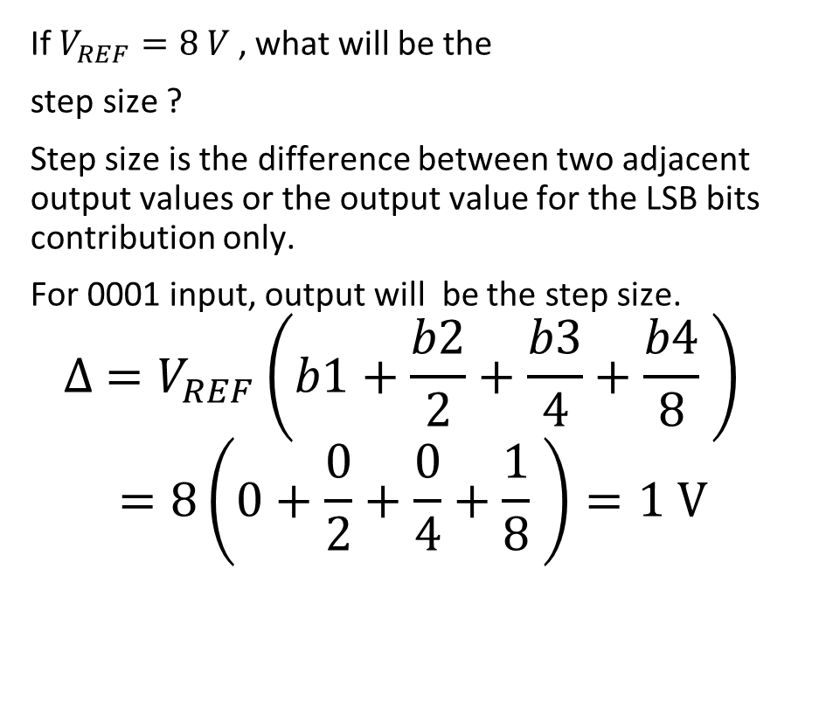
Step Size
If $V_{REF}=8 V$, what will be the
step size ?
Step size is the difference between two adjacent output values or the output value for the LSB bits contribution only.
For 0001 input, output will be the step size.
$$∆ =V_{REF}\left(b1+\frac{b2}{2}+\frac{b3}{4}+\frac{b4}{8} \right)$$
$$=8\left(0+\frac{0}{2}+\frac{0}{4}+\frac{1}{8} \right)=1 V$$

Slide 11
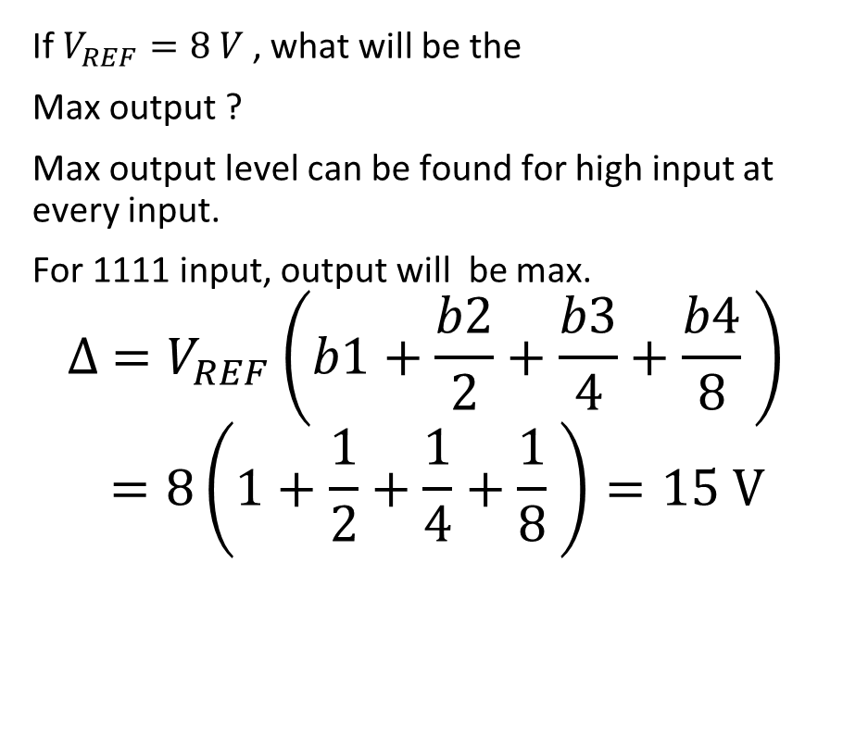
Maximum Output
If $V_{REF}=8 V$, what will be the
Max output ?
Max output level can be found for high input at every input.
For 1111 input, output will be max.
$$∆ =V_{REF}\left(b1+\frac{b2}{2}+\frac{b3}{4}+\frac{b4}{8} \right)$$
$$=8\left(1+\frac{1}{2}+\frac{1}{4}+\frac{1}{8} \right)=15 V$$

Slide 12
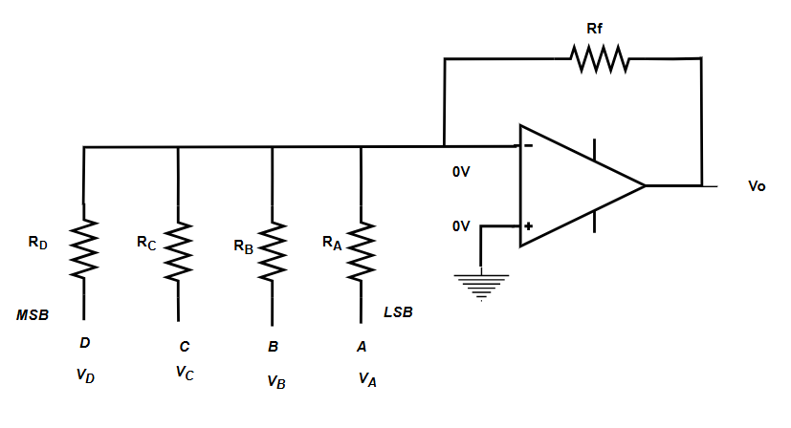
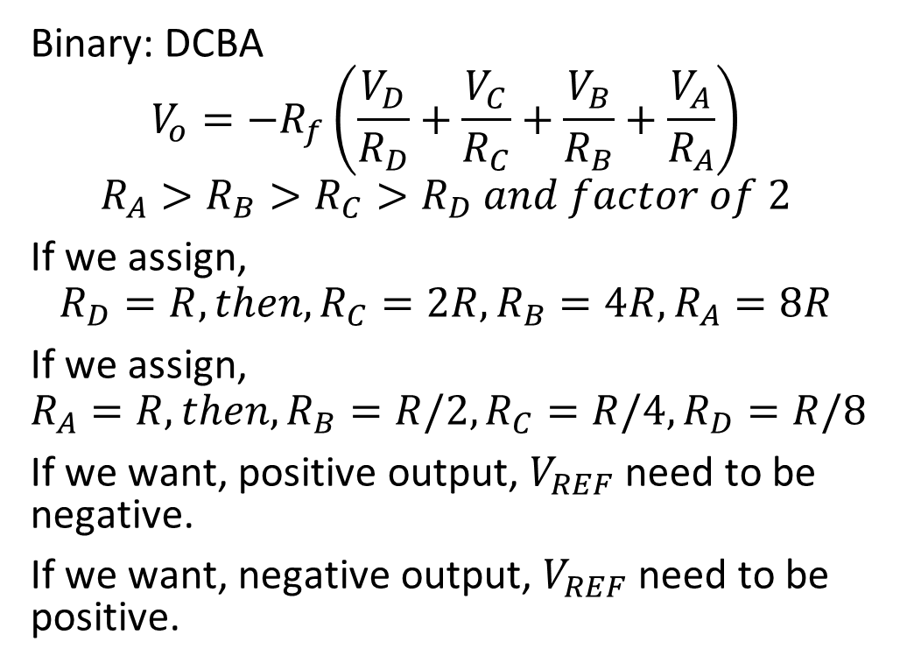
General Formula for DAC
Binary: DCBA
$$V_{o}=−R_{f}\left(\frac{V_{D}}{R_{D}}+\frac{V_{C}}{R_{C}}+\frac{V_{B}}{R_{B}}+\frac{V_{A}}{R_{A}}\right)$$
$$R_{A}>R_{B}>R_{C}>R_{D} and factor of 2$$
If we assign,
$$R_{D}=R, then, R_{C}=2R, R_{B}=4R, R_{A}=8R$$
If we assign,
$$R_{A}=R, then, R_{B}=R/2, R_{C}=R/4, R_{D}=R/8$$
If we want, positive output, $V_{REF}$need to be negative.
If we want, negative output, $V_{REF}$need to be positive.

Slide 13
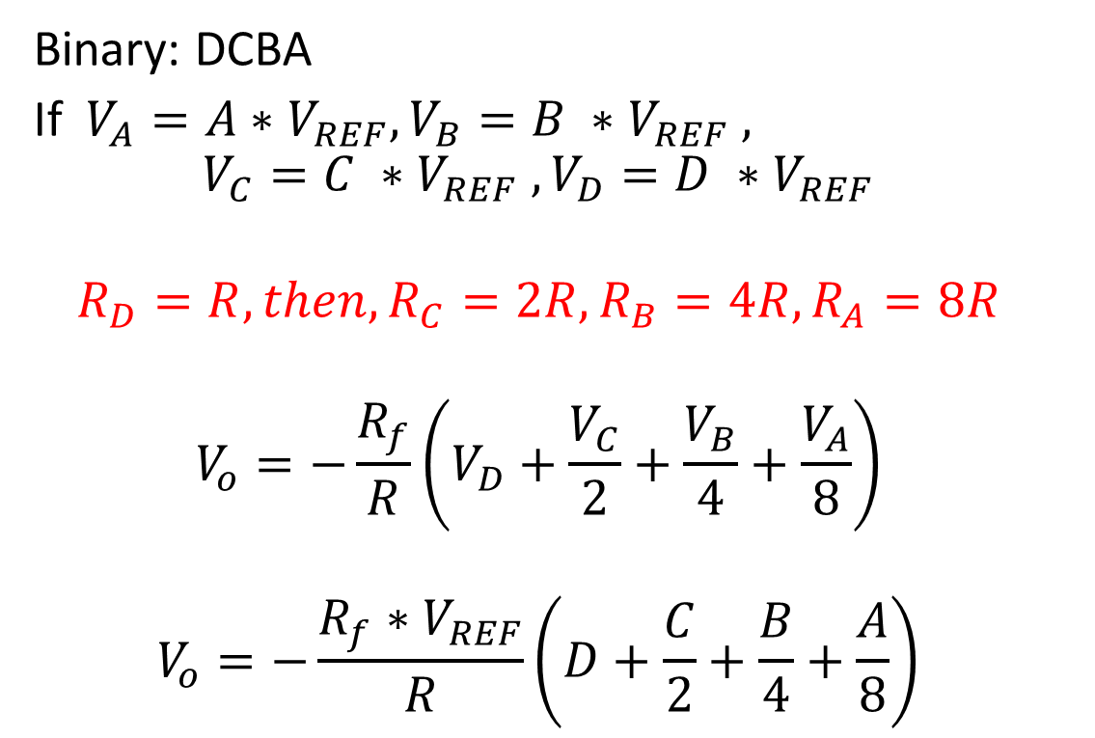
DAC (MSB→ R)
Binary: DCBA
If $V_{A}=A∗V_{REF}, V_{B}=B ∗V_{REF} ,$
$$V_{C}=C ∗V_{REF} , V_{D}=D ∗V_{REF}$$
$$R_{D}=R, then, R_{C}=2R, R_{B}=4R, R_{A}=8R$$
$$V_{o}=−\frac{R_{f}}{R}\left(V_{D}+\frac{V_{C}}{2}+\frac{V_{B}}{4}+\frac{V_{A}}{8}\right)$$
$$V_{o}=−\frac{R_{f}∗V_{REF}}{R}\left(D+\frac{C}{2}+\frac{B}{4}+\frac{A}{8}\right)$$

Slide 14
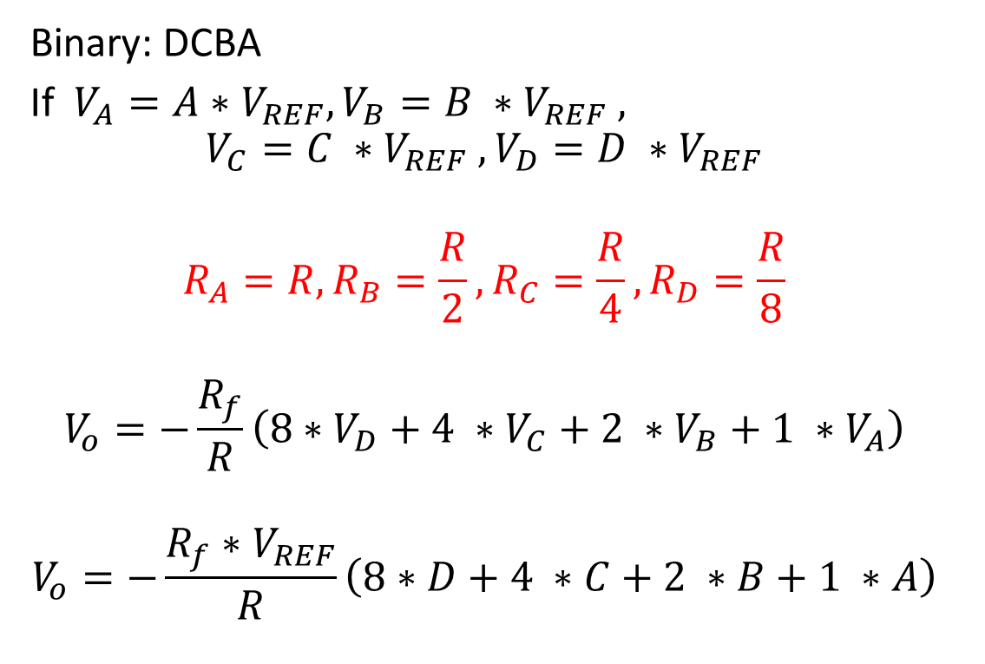
DAC (LSB → R)
Binary: DCBA
If $V_{A}=A∗V_{REF}, V_{B}=B ∗V_{REF} ,$
$$V_{C}=C ∗V_{REF} , V_{D}=D ∗V_{REF}$$
$$R_{A}=R,R_{B}=\frac{R}{2},R_{C}=\frac{R}{4},R_{D}=\frac{R}{8}$$
$$V_{o}=−\frac{R_{f}}{R}\left(8∗V_{D}+4 ∗V_{C}+2 ∗V_{B}+1 ∗V_{A}\right)$$
$$V_{o}=−\frac{R_{f}∗V_{REF}}{R}\left(8∗D+4 ∗C+2 ∗B+1 ∗A\right)$$

Slide 15
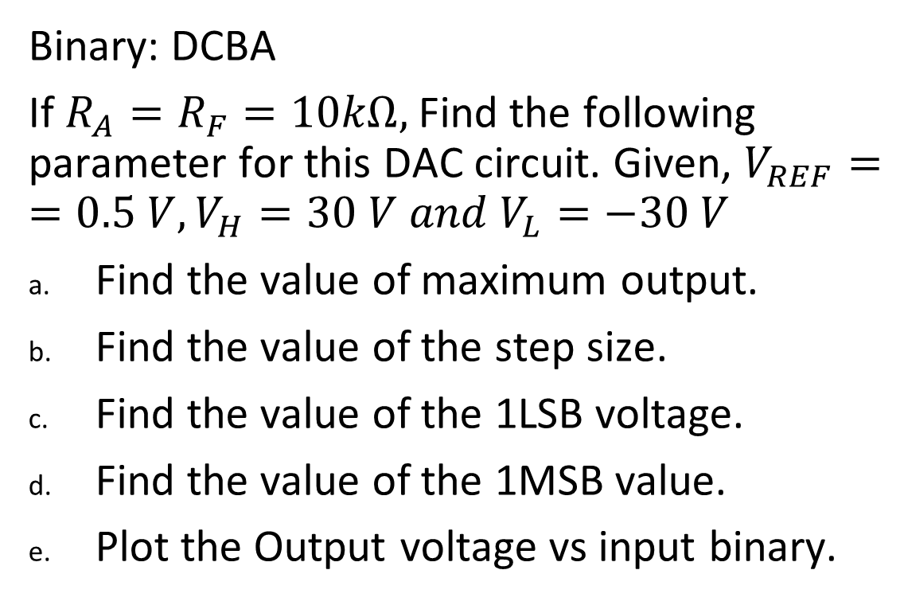
Exercise:
Binary: DCBA
If $R_{A}=R_{F}=10kΩ,$Find the following parameter for this DAC circuit. Given, $V_{REF}==0.5 V, V_{H}=30 V and V_{L}=−30 V$
Find the value of maximum output.
Find the value of the step size.
Find the value of the 1LSB voltage.
Find the value of the 1MSB value.
Plot the Output voltage vs input binary.

Slide 16
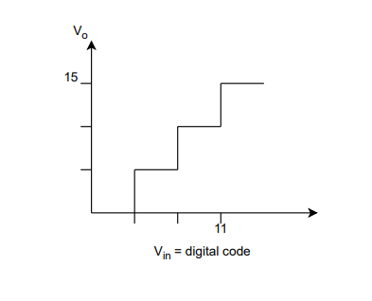
Exercise:
The figure below shows the input-output characteristics of a converter. The output of the converter is denoted as V0 and the input as Vin. Identify the converter type and the number of bits used by the converter. Further, calculate Vref when RF = 2R.

